Slide 1
Lecture 03 Semiconductor Physics
Prepared By
Dr. Eng. Sherif Hekal
Assistant Professor, CCE department

Slide 2
ILOS
In this section, we will learn:
The basic properties of semiconductors and, in particular, silicone – the material used to make most modern electronic circuits.
How doping a pure silicon crystal dramatically changes electrical conductivity – the fundamental idea in underlying the use of semiconductors in the implementation of electronic devices.
The two mechanisms by which current flows in semiconductors – drift and diffusion charge carriers.
The structure and operation of the pn junction – a basic semiconductor structure that implements the diode and plays a dominant role in semiconductors.

Slide 3
Agenda
Current Flow in Semiconductors
The pn Junction with Open-Circuit Terminals (Equilibrium)
The pn Junction with Applied Voltage
Capacitive Effects in the pn Junction

Slide 4
Intrinsic Semiconductors
Q: Why can thermal generation not be used to affect meaningful current conduction?
A: Silicon crystal structure described previously is not sufficiently conductive at room temperature.
Additionally, a dependence on temperature is not desirable.
Q: How can this “problem” be fixed?
A: doping
doping – is the intentional introduction of impurities into an extremely pure (intrinsic) semiconductor for the purpose changing carrier concentrations.
Notes:
Doping is placing pure crystalline silicon in an environment with a gas containing the desired impurity and elevating the temperature so that high energy atoms penetrate the silicon and randomly bump out some silicon atoms.

Slide 5
Doped Semiconductors
A semiconductor material that has been subjected to the doping process is called an extrinsic material.
p-type semiconductor
Silicon is doped with element having a valence of 3.
To increase the concentration of holes (p).
One example is boron, which is an acceptor.
n-type semiconductor
Silicon is doped with element having a valence of 5.
To increase the concentration of free electrons (n).
One example is phosophorus, which is a donor.
Notes:
Look at the periodic table of the elements. The columns correspond to the number of valence electrons.
The intrinsic silicon crystal described above has equal concentrations of free electrons and holes, generated by thermal generation. These concentrations are far too small for silicon to conduct appreciable current at room temperature. Also, the carrier concentrations and hence the conductivity are strong functions of temperature, not a desirable property in an electronic device. Fortunately, a method was developed to change the carrier concentration in a
semiconductor crystal substantially and in a precisely controlled manner. This process is known as doping, and the resulting silicon is referred to as doped silicon.

Slide 6
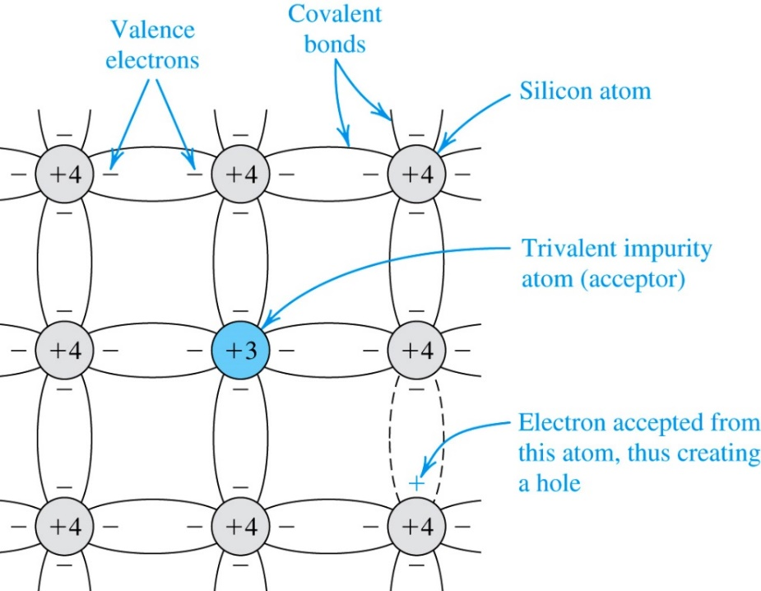
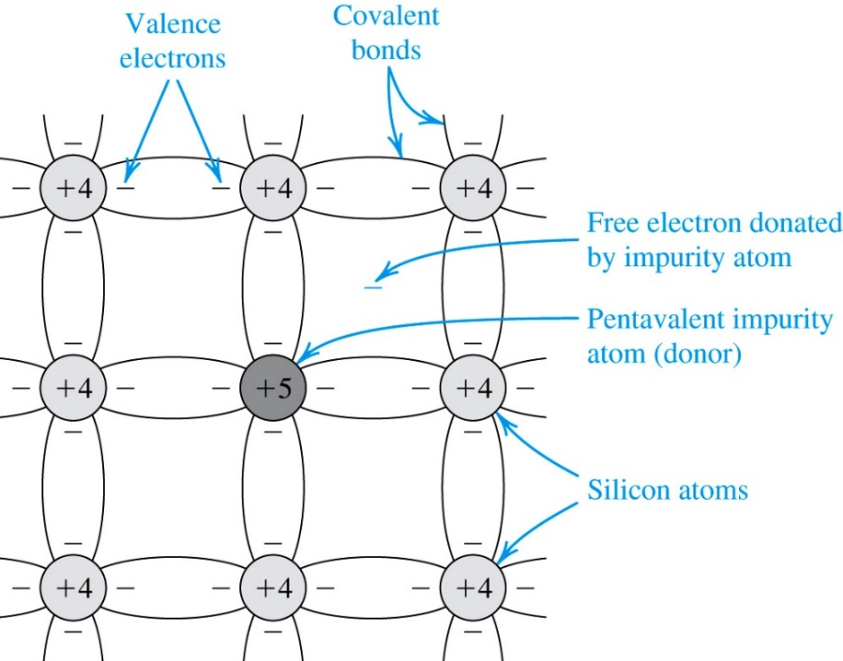
Doped Semiconductors
p-type semiconductor
n-type semiconductor

Slide 7
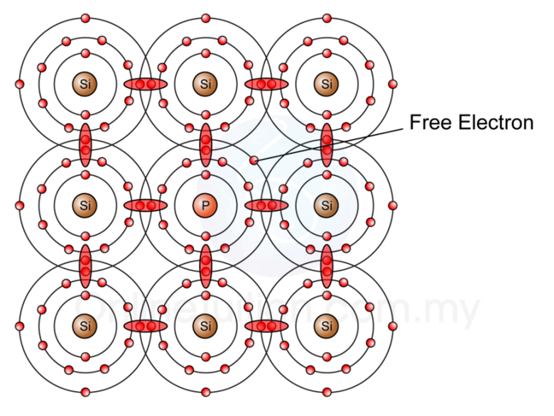
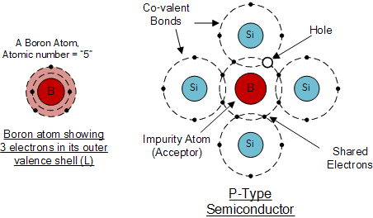
N-type
p-type

Slide 8
Doped Semiconductors
p-type doped semiconductor
If N_{A} is much greater than n_{i} …
concentration of acceptor atoms is N_{A}
Then the concentration of holes in the p-type is defined as below.

Slide 9
Doped Semiconductors
n-type doped semiconductor
If N_{D} is much greater than n_{i} …
concentration of donor atoms is N_{D}
Then the concentration of electrons in the n-type is defined as below.
The key here is that number of free electrons (conductivity) is dependent on doping concentration, not temperature…

Slide 10
Doped Semiconductors
p-type semiconductor
Q: How can one find the concentration?
A: Use the formula to right, adapted for the p-type semiconductor.
Notes:
These are “densities”

Slide 11
Doped Semiconductors
n-type semiconductor
Q: How can one find the concentration?
A: Use the formula to right, adapted for the n-type semiconductor.

Slide 12
Doped Semiconductors
p-type semiconductor
n_{p} will have the same dependence on temperature as n_{i}²
the concentration of holes (p_{n}) will be much larger than free electrons
holes are the majority charge carriers
free electrons are the minority charge carrier
n-type semiconductor
p_{n} will have the same dependence on temperature as n_{i}²
the concentration of free electrons (n_{n}) will be much larger than holes
electrons are the majority charge carriers
holes are the minority charge carrier

Slide 13
Doped Semiconductors
It should be emphasized that a piece of n-type or p-type silicon is electrically neutral; the charge of the majority free carriers (electrons in the n-type and holes in the p-type silicon) are neutralized by the bound charges associated with the impurity atoms.
Let
n_{o} : thermal-equilibrium concentration of electrons
p_{o} : thermal-equilibrium concentration of holes
N_{d} : concentration of donor atoms
N_{a} : concentration of acceptor atoms
N_{d}+ : concentration of positively charged donors (ionized donors)
N_{a}- : concentration of negatively charged acceptors (ionized acceptors)

Slide 14
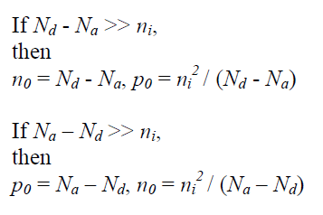
Doped Semiconductors
At equilibrium, the product of the majority and minority carrier concentration is a constant, and this is mathematically expressed by the Law of Mass Action.
by the charge neutrality condition, n₀ + N_{a}⁻ = p₀ + N_{d}⁺

Slide 15
Example 2: Doped Semiconductor
Consider an n-type silicon for which the dopant concentration is N_{D} = 10¹⁷/cm³. Find the electron and hole concentrations at T = 300K.
^{Solution}
The concentration of the majority electrons is
$$n_{n}≃N_{D}={10}^{17} /{cm}^{3}$$
The concentration of the minority holes is
$$p_{n}≃\frac{{n_{i}}^{2}}{N_{D}}$$
In Example 1, we found that at T = 300 K,
$n_{i}=1.5×{10}^{10}/{cm}^{3}$. Thus,
$$p_{n}≃\frac{{\left(1.5×{10}^{10}\right)}^{2}}{{10}^{17}}=2.25×{10}^{3}/{cm}^{3}$$
Observe that $n_{n}≫n_{i}$ and that $n_{n}$ is vastly higher than $p_{n}$.

Slide 16
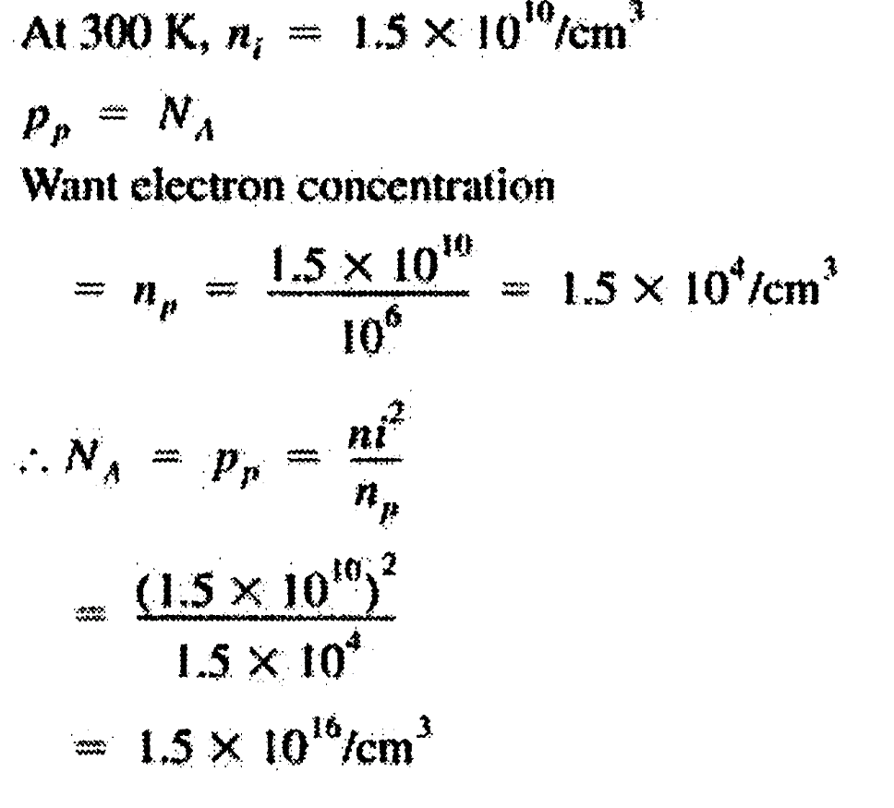
Example 3 : Doped Semiconductor
For a silicon crystal doped with boron, what must N_{A} be if at T = 300 K the electron concentration drops below the intrinsic level by a factor of 10⁶?

Slide 17
Current Flow in Semiconductors

Slide 18
1. Drift Current
There are two distinctly different mechanisms for the movement of charge carriers and hence for current flow in semiconductors: drift and diffusion.
Q: What happens when an electrical field (E) is applied to a semiconductor crystal?
A: Holes are accelerated in the direction of E, free electrons are attracted.
Q: How is the velocity of these carriers defined?
Notes:
The electric field is determined by applied voltages (divided by the distance between the voltages)

Slide 19
1. Drift Current
note that electrons move with velocity 2.5 times higher than holes
.E (volts / cm)
.μ_{p} (cm²/Vs) = 480 for silicon
.μ_{n} (cm²/Vs) = 1350 for silicon
Notes:
The carriers move slowly, not at the speed of light, but signals can move at near the speed of light.
hole mobility: It represents the degree of ease by which holes move through the silicon crystal in response to the electrical field E. v_{n}-drift where the result is negative because the electrons move in the direction opposite to E.
The mobility is proportional to the carrier relaxation time and inversely proportional to the carrier effective mass. The electron mobilty is often greater than hole mobility because quite often, the electron effective mass is smaller than hole effective mass.

Slide 20
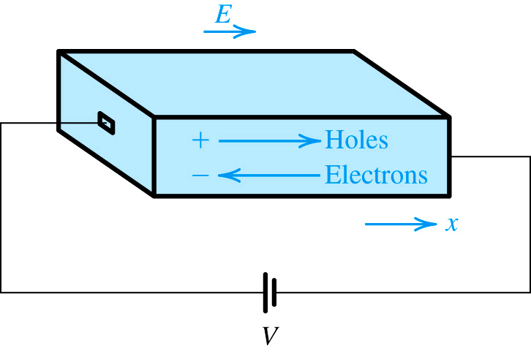
3.3.1. Drift Current
An electric field E established in a bar of silicon causes the holes to drift in the direction of E and the free electrons to drift in the opposite direction. Both the hole and electron drift currents are in the direction of E.
Q: What happens when an electrical field (E) is applied to a semiconductor crystal?
A: Holes are accelerated in the direction of E, free electrons are repelled.
Q: How is the velocity of these holes defined?
HOLES
ELECTRONS

Slide 21
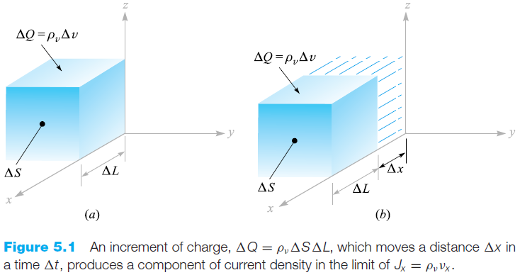
Current and Current Density
Current density may be related to the velocity of volume charge density at a point.
Consider the element of charge $∆Q=ρ_{v}∆v=ρ_{v}∆S∆L$, as shown in Figure (a).

Slide 22
Current and Current Density
To simplify the explanation, assume that the charge element is oriented to the x-axis and has only an x component of velocity $∆Q=ρ_{v}∆S∆x$.
If the charge element $∆Q$moved a distance $∆x$ in the time interval $∆t$, as indicated in Figure (b), the resulting current will be
Where $v_{x}$ represents the x component of the velocity v. In terms of current density,
we find
and in general

Slide 23
1. Drift Current
Assume that, for the single-crystal silicon bar on previous slide, the concentration of holes is defined as p and electrons as n.
Q: What is the current component attributed to the flow of holes (not electrons)?

Slide 24
1. Drift Current
step #1: Consider a plane perpendicular to the x direction.
step #2: Define the hole charge that crosses this plane.

Slide 25
1. Drift Current
PART A: What is the current component attributed to the flow of holes (not electrons)?
step #3: Substitute in μ_{p}E.
step #4: Define current density as J_{p} = I_{p} / A.

Slide 26
1. Drift Current
Q: What is the current component attributed to the flow of electrons (not holes)?
A: to the right…
Q: How is total drift current defined?
A: to the right…

Slide 27
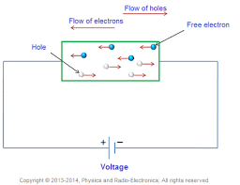
1. Drift Current

Slide 28
1. Drift Current
conductivity (σ.) – relates current density (J) and electrical field (E)
resistivity (ρ.) – relates current density (J) and electrical field (E)

Slide 29
Example 4: Drift current
Q(a): Find the resistivity of intrinsic silicon using following values – μ_{n} = 1350cm²/Vs, μ_{p} = 480cm²/Vs, n_{i} = 1.5x10¹⁰/cm³.
Q(b): Find the resistivity of p-type silicon with N_{A} = 10¹⁶/cm² and using the following values – μ_{n} = 1110cm²/Vs, μ_{p} = 400cm²/Vs, n_{i} = 1.5x10¹⁰/cm³
note that doping reduces carrier mobility

Slide 30
Example 5: Drift current
(a) For intrinsic silicon,
p = n = n_{i} = 1.5 × 10¹⁰ ⁄ cm³
(b) For the p-type silicon
$$p_{p}≃N_{A}={10}^{16}/{cm}^{3}$$
$$n_{p}≃\frac{{n_{i}}^{2}}{N_{A}}=\frac{{\left(1.5×{10}^{10}\right)}^{2}}{{10}^{16}}=2.25×{10}^{4}/{cm}^{3}$$
Notes:
Observe that the resistivity of the p-type silicon is determined almost entirely by the doping concentration.
Also observe that doping the silicon reduces its resistivity by a factor of about , a truly remarkable change.

Slide 31
Note…
for intrinsic semiconductor – number of free electrons is n_{i} and number of holes is p_{i}
for p-type doped semiconductor – number of free electrons is n_{p} and number of holes is p_{p}
for n-type doped semiconductor – number of free electrons is n_{n} and number of holes is p_{n}
majority charge carriers
minority charge carriers

Slide 32
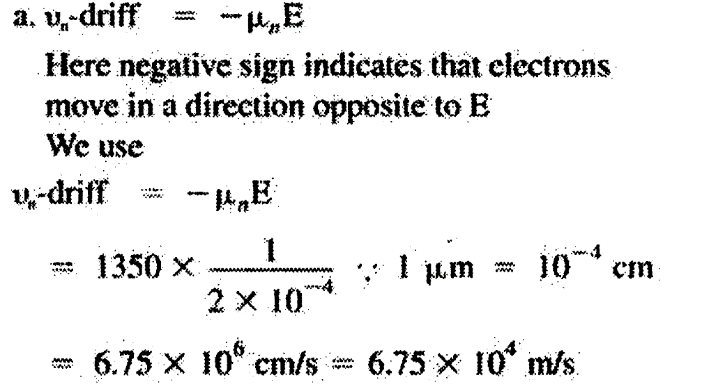
Example 6: Drift current
A uniform bar of n-type silicon of 2 μm length has a voltage of 1 V applied across it. If $N_{D}={10}^{6}/{cm}^{3}$and $μ_{n}=1350{cm}^{2}/V$.s, find (a) the electron drift velocity, (b) the time it takes an electron to cross the 2-μm length, (c) the drift-current density, and (d) the drift current in the case the silicon bar has a cross sectional area of $0.25{μm}^{2}$.

Slide 33
Example 6: Drift current, contd.
$b. Time taken to cross 2μ\text{m}$length
$$=\frac{distance}{v_{drift}}=\frac{2×{10}^{−6}}{6.75×{10}^{4}}=30ps$$
c. The current density $J_{n}$ is given by
$$J_{n}=qnμ_{n}E$$
$$=1.6×{10}^{−19}×{10}^{16}×1350×\frac{1}{2×{10}^{−4}}=1.08×{10}^{4} A/{cm}^{2}$$
$$d. Drift current I_{n}=J_{n}A$$
$I_{n}=0.25×{10}^{−8}×1.08×{10}^{4}=27μ$A

Slide 34
2. Diffusion Current
carrier diffusion – is the flow of charge carriers from area of high concentration to low concentration.
It requires non-uniform distribution of carriers.
diffusion current – is the current flow that results from diffusion.
Notes:
Such a diffusion process is like that observed if one drops a few ink drops in a water-filled tank. The diffusion of charge carriers gives rise to a net flow of charge, or diffusion current.

Slide 35
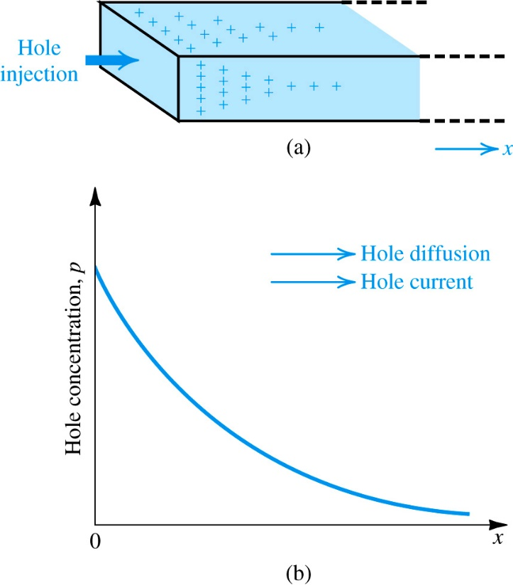
2. Diffusion Current
Take the following example…
inject holes – By some unspecified process, one injects holes in to the left side of a silicon bar.
concentration profile arises – Because of this continuous hole inject, a concentration profile arises.
diffusion occurs – Because of this concentration gradient, holes will flow from left to right.
inject holes
diffusion occurs
concentration profile arises
Notes:
The magnitude of the current at any point is proportional to
the slope of the concentration profile, or the concentration gradient, at that point,

Slide 36
2. Diffusion Current
Q: How is diffusion current defined?
Unit: A/cm²
Notes:
Note that the gradient dp(x)/dx is negative, resulting in a positive current in the x direction, as should be expected.
Observe that a negative (dn/dx) gives rise to a negative current, a result of the convention that the positive direction of current
is taken to be that of the flow of positive charge (and opposite to that of the flow of negative charge).

Slide 37
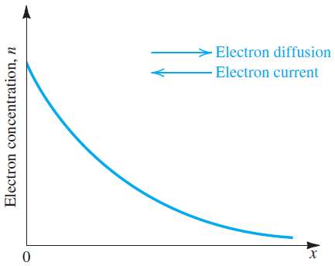
2. Diffusion Current
Observe that a negative (dn/dx) gives rise to a negative current, a result of the convention that the positive direction of current is taken to be that of the flow of positive charge (and opposite to that of the flow of negative charge).
Notes:
At this point the reader is probably wondering where the diffusion current in the silicon bar in Fig. 3.6(a) goes. A good question as we are not showing how the right-side end of the bar is connected to the rest of the circuit. We will address this and related questions in detail in our discussion of the pn junction in later sections.

Slide 38
Example 7: Diffusion current
Consider a bar of silicon in which a hole concentration p(x) described below is established.
Q(a): Find the hole-current density J_{p} at x = 0.
Q(b): Find current I_{p}.
Note the following parameters: p₀ = 10¹⁶/cm³, L_{p} = 1μm, A = 100μm²
Notes:
A = cross-sectional area of the bar

Slide 39
Example 7: Diffusion current, contd.

Slide 40
3. Relationship Between D and μ.?
Q: What is the relationship between diffusion constant (D) and mobility (μ)?
A: thermal voltage (V_{T})
Q: What is this value?
A: at T = 300K, V_{T} = 25.9mV
known as Einstein Relationship

Slide 41
Summary of Semiconductor currents
drift current density (J_{drift})
affected by – an electric field (E).
diffusion current density (J_{diff})
affected by – concentration gradient in free electrons and holes.

Slide 42
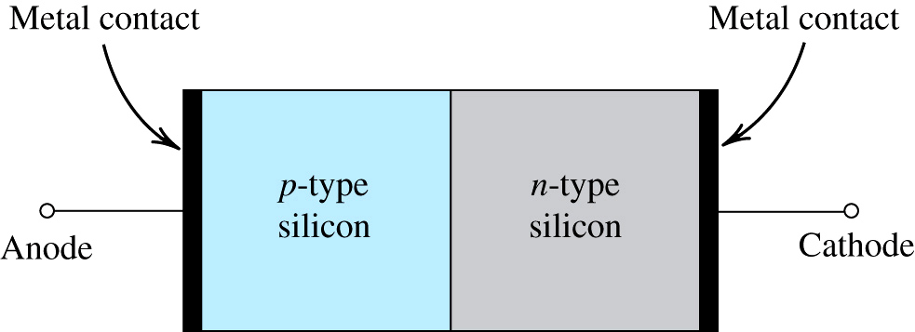
4. The pn Junction with Open-Circuit Terminals 4.1. Physical Structure
pn junction structure
p-type semiconductor
n-type semiconductor
metal contact for connection
Simplified physical structure of the pn junction. As the pn junction implements the junction diode, its terminals are labeled anode and cathode.
Notes:
This is a semiconductor diode. Anode and cathode are old terms from vacuum tube circuits.
In actual practice, both the p and n regions are part of the same silicon crystal; that is, the pn junction is formed within a single silicon crystal by creating regions of different dopings (p and n regions).
Having learned important semiconductor concepts, we are now ready to consider our first practical semiconductor structure—the pn junction. As mentioned previously, the pn junction implements the diode (Chapter 4) and plays the dominant role in the structure and operation of the bipolar junction transistor (BJT). As well, understanding pn junctions is very important to the study of the MOSFET operation

Slide 43
4.2. Operation with Open-Circuit Terminals
Q: What is state of pn junction with open-circuit terminals?
A: Read the below…
p-type material contains majority of holes
these holes are neutralized by equal amount of bound negative charge
n-type material contains majority of free electrons
these electrons are neutralized by equal amount of bound positive charge

Slide 44
4.2. Operation with Open-Circuit Terminals
bound charge
charge of opposite polarity to free electrons / holes of a given material
neutralizes the electrical charge of these majority carriers
does not affect concentration gradients
free holes
free electrons
negative bound charges
positive bound charges
p-type
n-type
Figure: The pn junction with no applied voltage (open-circuited terminals).
Notes:
The Diffusion Current I_{D}

Slide 45
4.2. Operation with Open-Circuit Terminals
Q: What happens when a pn-junction is newly formed – aka. when the p-type and n-type semiconductors first touch one another?
A: See following slides…

Slide 46
Step #1: The p-type and n-type semiconductors are joined at the junction.
p-type semiconductor filled with holes
n-type semiconductor filled with free electrons
junction
Figure: The pn junction with no applied voltage (open-circuited terminals).
Notes:
The distribution of carriers is approximately uniform (but random).

Slide 47
Step #2: Diffusion begins. Those free electrons and holes which are closest to the junction will recombine and, essentially, eliminate one another.
p-type
n-type
Figure: The pn junction with no applied voltage (open-circuited terminals).

Slide 48
Step #3: The depletion region begins to form – as diffusion occurs and free electrons recombine with holes.
The depletion region is filled with “uncovered” bound charges – who have lost the majority carriers to which they were linked.
p-type
n-type
Figure: The pn junction with no applied voltage (open-circuited terminals).
Notes:
Now the distribution near the junction is not uniform due to recombination.

Slide 49
Step #4: The “uncovered” bound charges affect a voltage differential across the depletion region. The magnitude of this barrier voltage (V₀) differential grows, as diffusion continues.
No voltage differential exists across regions of the pn-junction outside of the depletion region because of the neutralizing effect of positive and negative bound charges.
voltage potential
barrier voltage (V_{o})
p-type
n-type
location (x)
Notes:
Barrier in that it resists current flow.

Slide 50
Step #5: The barrier voltage (V₀) is an electric field whose polarity opposes the direction of diffusion current (I_{D}). As the magnitude of V₀ increases, the magnitude of I_{D} decreases.
diffusion current (I_{D})
drift current (I_{S})
p-type
n-type
Figure: The pn junction with no applied voltage (open-circuited terminals).

Slide 51
Step #6: Equilibrium is reached, and diffusion ceases, once the magnitudes of diffusion and drift currents equal one another – resulting in no net flow.
Once equilibrium is achieved, no net current flow exists (I_{net} = I_{D} – I_{S}) within the pn-junction while under open-circuit condition.
diffusion current (I_{D})
drift current (I_{S})
p-type
depletion region
n-type

Slide 52
4.2. Operation with Open-Circuit Terminals
pn-junction built-in voltage (V₀) – is the equilibrium value of barrier voltage.
It is defined to the right.
Generally, it takes on a value between 0.6 and 0.9V for silicon at room temperature.
This voltage is applied across depletion region, not terminals of pn junction.
Power cannot be drawn from V₀.
Notes:
And the terminal voltage needs to exceed the barrier voltage before appreciable current flows.

Slide 53
Report 1

Slide 54
The Drift Current I_{S} and Equilibrium
In addition to majority-carrier diffusion current (I_{D}), a component of current due to minority carrier drift exists (I_{S}).
Specifically, some of the thermally generated holes in the p-type and n-type materials move toward and reach the edge of the depletion region.
Therefore, they experience the electric field (V₀) in the depletion region and are swept across it.
Unlike diffusion current, the polarity of V₀ reinforces this drift current.
Notes:
I_{s}is the leakage current that flows when the diode is reverse biased.

Slide 55
4.2. Operation with Open-Circuit Terminals
Because these holes and free electrons are produced by thermal energy, I_{S} is heavily dependent on temperature
Any depletion-layer voltage, regardless of how small, will cause the transition across junction. Therefore I_{S} is independent of V₀.
drift current (I_{S}) – is the movement of these minority carriers.
aka. electrons from p-side to n-side of the junction

Slide 56
Note that the magnitude of drift current (I_{S}) is unaffected by level of diffusion and / or V₀. It will be, however, affected by temperature.
diffusion current (I_{D})
drift current (I_{S})
Figure: The pn junction with no applied voltage (open-circuited terminals).

Slide 57
4.2. Operation with Open-Circuit Terminals
Q: How is the charge stored in both sides of the depletion region defined?
A: Refer to equations to right. Note that these values should equal one another.

Slide 58
4.2. Operation with Open-Circuit Terminals
Q: What information can be derived from this equality?
A: In reality, the depletion region exists almost entirely on one side of the pn-junction – due to great disparity between N_{A} > N_{D}.

Slide 59
4.2. Operation with Open-Circuit Terminals
Note that both x_{p} and x_{n} may be defined in terms of the depletion region width (W).

Slide 60
4.2. Operation with Open-Circuit Terminals
Note, also, the charge on either side of the depletion region may be calculated via (3.29) and (3.30).

Slide 61
4.2. Operation with Open-Circuit Terminals
Q: What has been learned about the pn-junction?
A: composition
The pn junction is composed of two silicon-based semiconductors, one doped to be p-type and the other n-type.
A: majority carriers
Are generated by doping.
Holes are present on p-side, free electrons are present on n-side.

Slide 62
3.4.2. Operation with Open-Circuit Terminals
Q: What has been learned about the pn-junction?
A: bound charges
Charge of majority carriers are neutralized electrically by bound charges.
A: diffusion current I_{D}
Those majority carriers close to the junction will diffuse across, resulting in their elimination.

Slide 63
4.2. Operation with Open-Circuit Terminals
Q: What has been learned about the pn-junction?
A: depletion region
As these carriers disappear, they release bound charges and effect a voltage differential V₀.
A: depletion-layer voltage
As diffusion continues, the depletion layer voltage (V₀) grows, making diffusion more difficult and eventually bringing it to halt.

Slide 64
4.2. Operation with Open-Circuit Terminals
Q: What has been learned about the pn-junction?
A: minority carriers
Are generated thermally.
Free electrons are present on p-side, holes are present on n-side.
A: drift current I_{S}
The depletion-layer voltage (V₀) facilitates the flow of minority carriers to opposite side.
A: open circuit equilibrium I_{D} = I_{S}

Slide 65
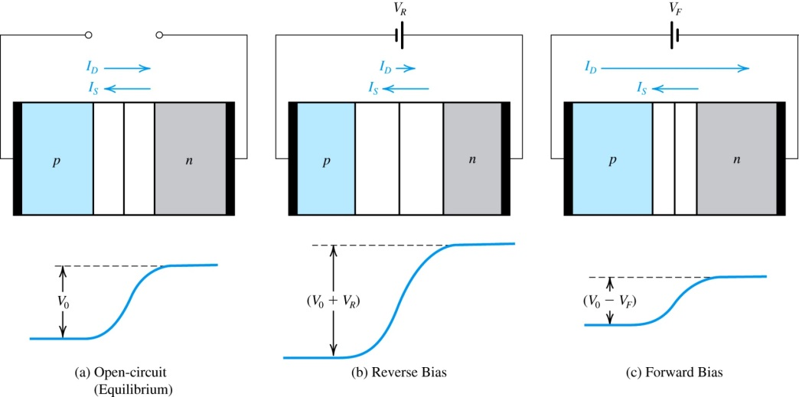
5. The pn Junction with an Applied Voltage 5.1. Qualitative Description of Junction Operation
Figure to right shows pn-junction under three conditions:
(a) open-circuit – where a barrier voltage V₀ exists.
(b) reverse bias – where a dc voltage V_{R} is applied.
(c) forward bias – where a dc voltage V_{F} is applied.
Figure 11: The pn junction in: (a) equilibrium; (b) reverse bias; (c) forward bias.
Notes:
This determines the Diode V-I curve.
Observe that in the open-circuit case, a barrier voltage develops, making n more positive than p, and limiting the diffusion current to a value exactly equal to the drift current , thus resulting in a zero current at the junction terminals, as should be the case since the terminals are open circuited.
Consider now the reverse-bias case in (b). The externally applied reverse-bias voltage is in the direction to add to the barrier voltage, and it does, thus increasing the effective barrier voltage to as shown. This reduces the number of holes that diffuse into the n region and the number of electrons that diffuse into the p. The end result is that the diffusion current is dramatically reduced.

Slide 66
1) no voltage applied
2) voltage differential across depletion zone is V₀
3) I_{D} = I_{S}
1) negative voltage applied
2) voltage differential across depletion zone is V₀ + V_{R}
3) I_{D} < I_{S}
1) positive voltage applied
2) voltage differential across depletion zone is V₀ - V_{F}
3) I_{D} > I_{S}
Figure to right shows pn-junction under three conditions:
(a) open-circuit – where a barrier voltage V₀ exists.
(b) reverse bias – where a dc voltage V_{R} is applied.
(c) forward bias – where a dc voltage V_{F} is applied.
Figure 3.11: The pn junction in: (a) equilibrium; (b) reverse bias; (c) forward bias.

Slide 67
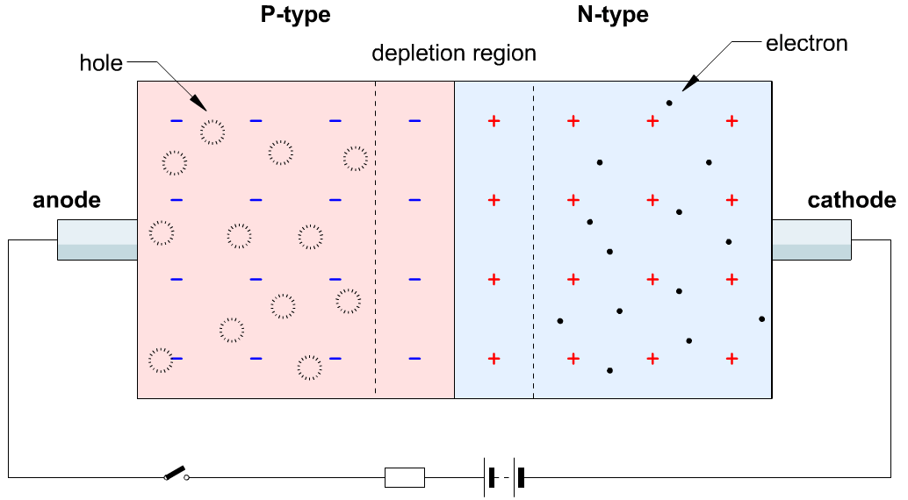
5.1. Qualitative Description of Junction Operation

Slide 68
5.1. Qualitative Description of Junction Operation
reverse bias case
the externally applied voltage V_{R} adds to the barrier voltage V₀
…increase effective barrier
this reduces rate of diffusion, reducing I_{D}
if V_{R} > 1V, I_{D} will fall to 0A
the drift current I_{S} is unaffected, but dependent on temperature
result is that pn junction will conduct small drift current I_{S}
forward bias case
the externally applied voltage V_{F} subtracts from the barrier voltage V₀
…decrease effective barrier
this increases rate of diffusion, increasing I_{D}
the drift current I_{S} is unaffected, but dependent on temperature
result is that pn junction will conduct significant current I_{D} - I_{S}
minimal current flows in reverse-bias case
significant current flows in forward-bias case
Notes:
So the diode is approximately a “one-way” valve!

Slide 69
Forward-Bias Case
Observe that decreased barrier voltage will be accompanied by…
(1) decrease in stored uncovered charge on both sides of junction
(2) smaller depletion region
Width of depletion region shown to right.

Slide 70
Reverse-Bias Case
Observe that increased barrier voltage will be accompanied by…
(1) increase in stored uncovered charge on both sides of junction
(2) wider depletion region
Width of depletion region shown to right.
Notes:
Note that the diode in reverse bias looks like a parallel plate capacitor. Varactor diodes are used ac a voltage controlled capacitor.

Slide 71
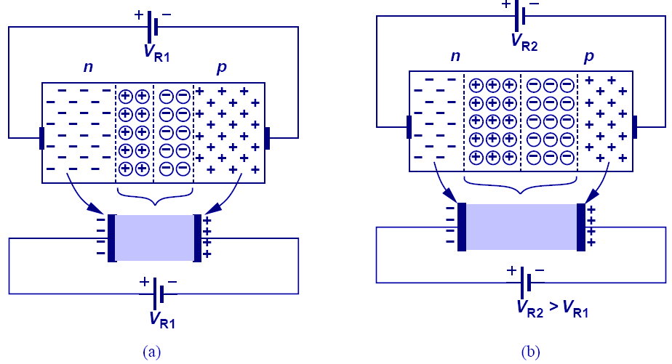
Reverse Biased Diode’s Application: Voltage-Dependent Capacitor
The PN junction can be viewed as a capacitor. By varying V_{R}, the depletion width changes, changing its capacitance value; therefore, the PN junction is actually a voltage-dependent capacitor.

Slide 72
Example 7: PN junctions

Slide 73
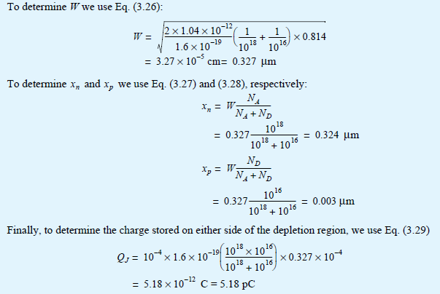

Slide 74
5.2. The Current-Voltage Relationship of the Junction
Q: What happens, exactly, when a forward-bias voltage (V_{F}) is applied to the pn-junction?
step #1: Initially, a small forward-bias voltage (V_{F}) is applied. It, because of its polarity, pushes majority carriers (holes in p-region and electrons in n-region) toward the junction and reduces width of the depletion zone.
Note, however, that this force is opposed by the built-in voltage (V₀).

Slide 75
step #1: Initially, a small forward-bias voltage (V_{F}) is applied. It, because of its polarity, pushes majority (holes in p-region and electrons in n-region) toward the junction and reduces width of the depletion zone.
V_{F}
Note that, in this figure, the smaller circles represent minority carriers and not bound charges – which are not considered here.
P-type
N-type
Figure: The pn junction with applied voltage.

Slide 76
step #2: As the magnitude of V_{F} increases, the depletion zone becomes thin enough such that the barrier voltage (V₀ – V_{F}) cannot stop diffusion current – as described in previous slides.
V_{F}
P-type
N-type
Figure: The pn junction with applied voltage.

Slide 77
step #3: Majority carriers (free electrons in n-region and holes in p-region) cross the junction and become minority charge carriers in the near-neutral region.
V_{F}
diffusion current (I_{D})
drift current (I_{S})
P-type
N-type
Figure: The pn junction with applied voltage.

Slide 78
step #4: The concentration of minority charge carriers increases on either side of the junction. A steady-state gradient is reached as rate of majority carriers crossing the junction equals that of recombination.
V_{F}
For the open-circuit condition, minority carriers are evenly distributed throughout the non-depletion regions. This concentration is defined as either n_{p0} or p_{n0}.
minority carrier concentration
n_{p0}
p_{n0}
P-type
N-type
location (x)
Figure: The pn junction with no applied voltage (open-circuited terminals).
Figure: The pn junction with applied voltage.

Slide 79
step #4: The concentration of minority charge carriers increases on either side of the junction. A steady-state gradient is reached as rate of majority carriers crossing the junction equals that of recombination.
V_{F}
minority carrier concentration
P-type
N-type
location (x)

Slide 80
step #5+: Diffusion current is maintained – in spite low diffusion lengths (e.g. microns) and recombination – by constant flow of both free electrons and holes towards the junction.
recombination
V_{F}
flow of diffusion current (I_{D})
flow of holes
flow of electrons
P-type
N-type
Figure: The pn junction with applied voltage.

Slide 81
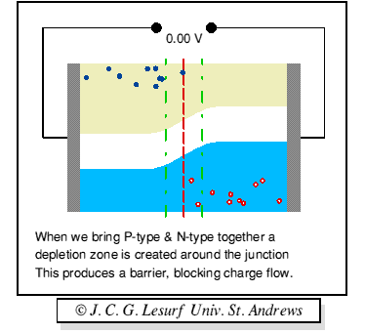
PN junction Characteristics
Conduction band
Valence band
N type
P type

Slide 82
5.2. The Current-Voltage Relationship of the Junction
Q: For forward-biased case, how is diffusion current (I_{D}) defined?

Slide 83
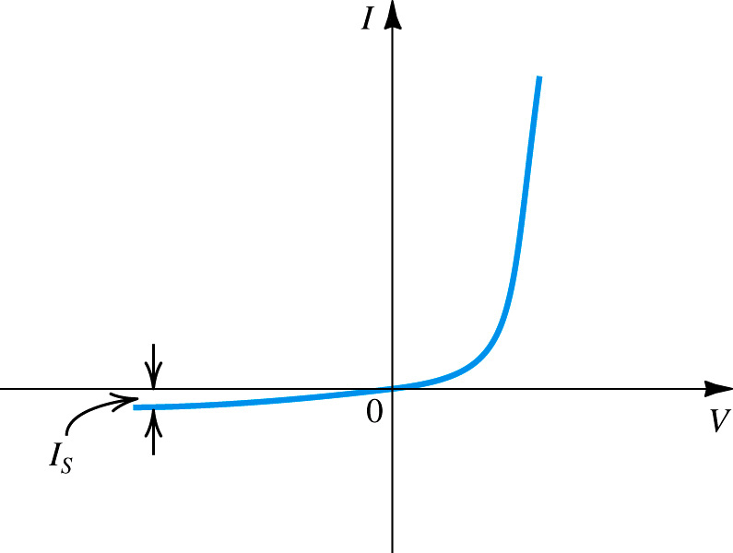
5.2. The Current-Voltage Relationship of the Junction
saturation current (I_{S}) – is the maximum reverse current which will flow through pn-junction.
It is proportional to cross-section of junction (A).
Typical value is 10⁻¹⁸A.
Figure 13: The pn junction I–V characteristic.

Slide 84
Example 6: pn-Junction
Consider a forward-biased pn junction conducting a current of I = 0.1mA with following parameters:
N_{A} = 10¹⁸/cm³, N_{D} = 10¹⁶/cm³, A = 10⁻⁴cm², n_{i} = 1.5e¹⁰/cm³, L_{p} = 5um, L_{n} = 10um, D_{p} (n-region) = 10cm²/s, D_{n} (p-region) = 18cm²/s
Q(a): Calculate I_{S} .
Q(b): Calculate the forward bias voltage (V).
Q(c): Component of current I due to hole injection and electron injection across the junction.

Slide 85
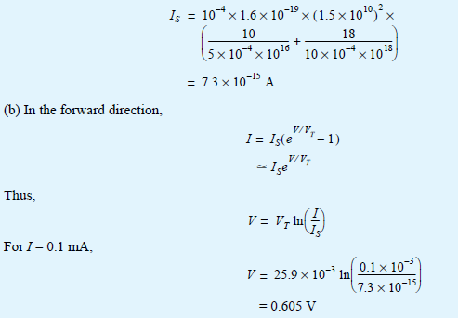
(a)

Slide 86
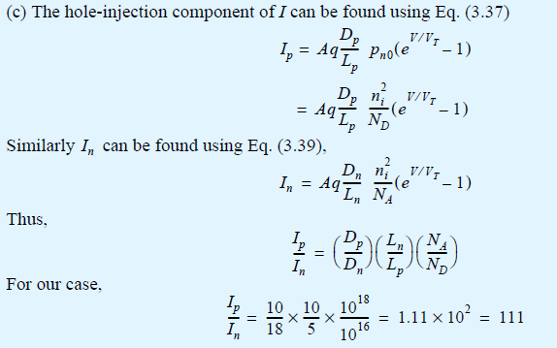

Slide 87
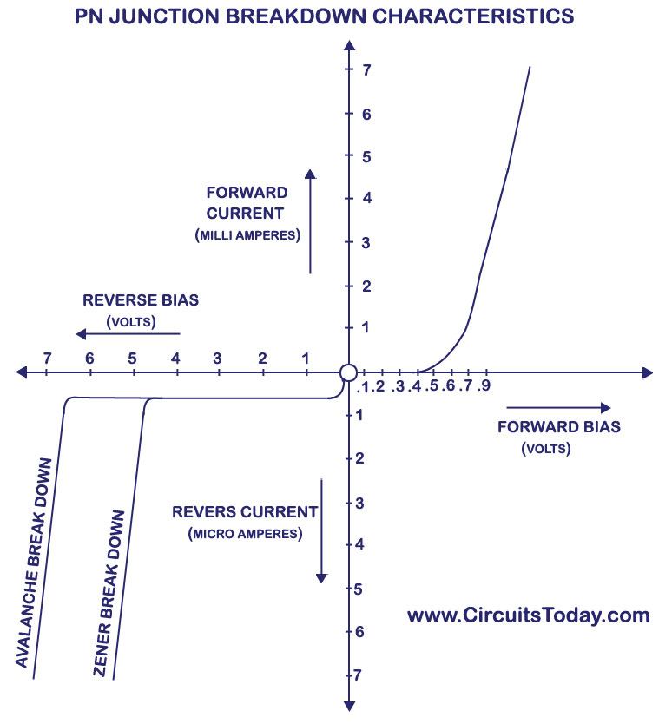
5.3 Reverse Breakdown
Notes:
Zener breakdown occurs when the electric field in the depletion layer increases to the point of breaking covalent bonds and generating electron-hole pairs. The electrons generated in this way will be swept by the electric field into the n side and the holes into the p side. Thus these electrons and holes constitute a reverse current across the junction. Once the zener effect starts, a large number of carriers can be generated, with a negligible increase in the
junction voltage. Thus the reverse current in the breakdown region will be large and its value must be determined by the external circuit, while the reverse voltage appearing between the diode terminals will remain close to the specified breakdown voltage VZ.

Slide 88
Zener breakdown
The electric field in the depletion layer increases to cause breaking covalent bonds and generating electron-hole pairs.
The electrons generated in this way will be swept by the electric field into the n side and the holes into the p side. Thus these electrons and holes constitute a reverse current across the junction.
Once the zener effect starts (V_{R}=5V), a large number of carriers can be generated, with a negligible increase in the junction voltage. Thus the reverse current in the breakdown region will be large and its value must be determined by the external circuit.
the reverse voltage appearing between the diode terminals will remain close to the specified breakdown voltage V_{Z}.

Slide 89
Avalanche breakdown
The minority carriers that cross the depletion region under the influence of the electric field gain sufficient kinetic energy to be able to break covalent bonds in atoms with which they collide.
The carriers liberated by this process may have sufficiently high energy to be able to cause other carriers to be liberated in another ionizing collision.
This process keeps repeating in the fashion of an avalanche, with the result that many carriers are created that are able to support any value of reverse current, as determined by the external circuit, with a negligible change in the voltage drop across the junction.

Slide 90
5.3 Reverse Breakdown
The maximum reverse-bias potential that can be applied before entering the breakdown region is called the peak inverse voltage (referred to simply as the PIV rating) or the peak reverse voltage (denoted the PRV rating).

Slide 91
6. Capacitive Effects in the pn Junction
Depletion or Junction Capacitance
When a pn junction is reverse biased
Diffusion Capacitance
When a pn junction is forward biased
Where
$τ_{T}$is the mean transit time of the junction.
I is the forward-bias current.

Slide 92
6. Capacitive Effects in the pn Junction
junction capacitance:
due to the dipole in the transition region (associated with the charge stored in the depletion region).
Also called transition region capacitance or depletion layer capacitance.
Dominates under reverse bias conditions.
Charge storage (Diffusion) capacitance:
associated with the minority carrier charge stored in the n and p materials as a result of the concentration profiles established by carrier injection.
Also referred to as diffusion capacitance.
Dominant when the junction is forward biased.

Slide 93
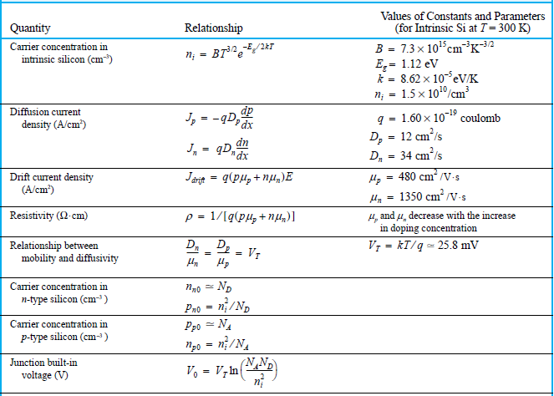
Summary of Important Equations

Slide 94
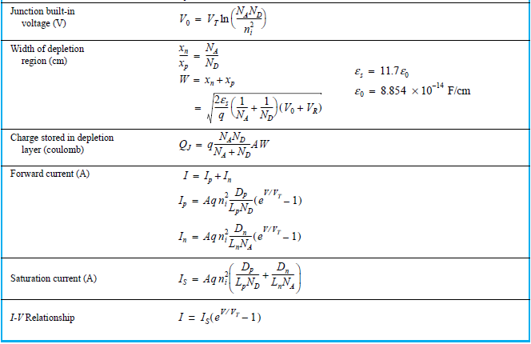
Summary of Important Equations

Slide 95
Summary (1)
Today’s microelectronics technology is almost entirely based on the semiconductor silicon. If a circuit is to be fabricated as a monolithic integrated circuit (IC), it is made using a single silicon crystal, no matter how large the circuit is.
In a crystal of intrinsic or pure silicon, the atoms are held in position by covalent bonds. At very low temperatures, all the bonds are intact; No charge carriers are available to conduct current. As such, at these low temperatures, silicone acts as an insulator.

Slide 96
Summary (2)
At room temperature, thermal energy causes some of the covalent bonds to break, thus generating free electrons and holes that become available to conduct electricity.
Current in semiconductors is carried by free electrons and holes. Their numbers are equal and relatively small in intrinsic silicon.
The conductivity of silicon may be increased drastically by introducing small amounts of appropriate impurity materials into the silicon crystal – via process called doping.

Slide 97
Summary (3)
There are two kinds of doped semiconductor: n-type in which electrons are abundant, p-type in which holes are abundant.
There are two mechanisms for the transport of charge carriers in a semiconductor: drift and diffusion.
Carrier drift results when an electric field (E) is applied across a piece of silicon. The electric field accelerates the holes in the direction of E and electrons oppositely. These two currents sum to produce drift current in the direction of E.

Slide 98
Summary (4)
Carrier diffusion occurs when the concentration of charge carriers is made higher in one part of a silicon crystal than others. To establish a steady-state diffusion current, a carrier concentration must be maintained in the silicon crystal.
A basic semiconductor structure is the pn-junction. It is fabricated in a silicon crystal by creating a p-region in proximity to an n-region. The pn-junction is a diode and plays a dominant role in the structure and operation of transistors.

Slide 99
Summary (5)
When the terminals of the pn-junction are left open, no current flows externally. However, two equal and opposite currents (I_{D} and I_{S}) flow across the junction. Equilibrium is maintained by a built-in voltage (V₀). Note, however, that the voltage across an open junction is 0V, since V₀ is cancelled by potentials appearing at the metal-to-semiconductor connection interfaces.
The voltage V₀ appears across the depletion region, which extends on both sides of the junction.

Slide 100
Summary (6)
The drift current I_{S} is carried by thermally generated minority electrons in the p-material that are swept across the depletion region into the n-side. The opposite occurs in the n-material. I_{S} flows from n to p, in the reverse direction of the junction. Its value is a strong function of temperature, but independent of V₀.
Forward biasing of the pn-junction, that is applying an external voltage that makes p more positive than n, reduces the barrier voltage to V₀ - V and results in an exponential increase in I_{D} (while I_{S} remains unchanged).

